Slide 1
Chapter 21
Recession and Depression

Slide 2
Introduction
Great events shape both the economy and the study of economics
Great Moderation
Modern macroeconomics grew out of the Great Depression
Great Recession of 2007-2009 brought an end to the Great Moderation
As bad as the Great Recession was, it would have been much worse if not for the lessons learned from the Great Depression

Slide 3
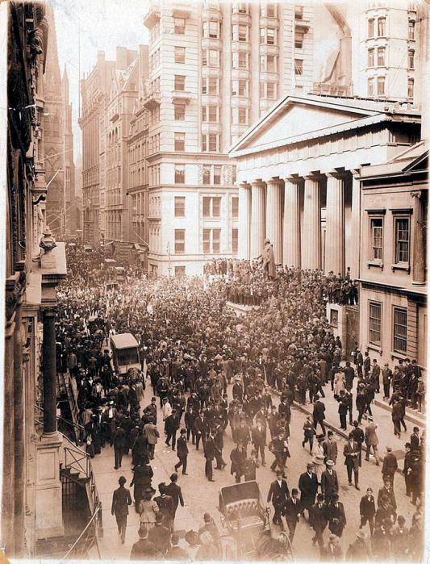
The Panic of 1907
The crisis in American banking in the early twentieth century
The money supply was not sufficiently responsive: It was difficult to shift currency around the country to respond quickly to local economic changes.
Bank panics (bank runs) were too common.
Notes:
All image credits courtesy of Morgue File and/or FreeImages.com unless otherwise specified

Slide 4
THE EVOLUTION OF THE AMERICAN BANKING SYSTEM
Responding to banking crises: the creation of the Federal Reserve
The panic of 1907 convinced many that the time for central control of bank reserves had come.
In 1913 the Federal Reserve was created.
Now bank reserves were centralized and standardized—but not immune to bank runs.
A series of bank runs in 1930, 1931, and 1933 convinced the Fed that banks needed more regulation.

Slide 5
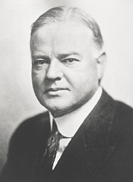
THE ORIGINS OF MACROECONOMICS
During the Great Depression, “Hoovervilles” sprang up across America, named after the President Herbert Hoover.
Notes:
All image credits courtesy of Morgue File and/or FreeImages.com unless otherwise specified

Slide 6
MACROECONOMICS: THE WHOLE IS GREATER THAN THE SUM OF ITS PARTS
An example
Paradox of thrift: When families and businesses are worried about the possibility of economic hard times, they prepare by cutting their spending.
This reduction in spending depresses the economy as consumers spend less and businesses react by laying off workers. As a result, families and businesses may end up worse off than if they hadn’t tried to act responsibly by cutting their spending.

Slide 7
Economic Stats of Great Depression
Year | GNP. 1992 $, Billions | I/GNP % | G, 1992 $, Billions | Unemployment Rate, % | CPI 1929 = 100 | Stock Market Index*
1929 | 938.1 | 17.8 | 121.9 | 3.2 | 100.0 | 83.1
1930 | 850.2 | 13.5 | 133.0 | 8.7 | 97.4 | 67.2
1931 | 784.9 | 9.0 | 137.7 | 15.9 | 88.7 | 43.6
1932 | 676.1 | 3.5 | 131.2 | 23.6 | 79.7 | 22.1
1933 | 662.1 | 3.8 | 127.6 | 24.9 | 75.4 | 28.6
1934 | 713.7 | 5.5 | 145.2 | 21.7 | 78.0 | 31.4
1935 | 777.4 | 9.2 | 148.5 | 20.1 | 80.1 | 33.9
1936 | 882.7 | 10.9 | 174.4 | 16.9 | 80.9 | 49.4
1937 | 923.5 | 12.8 | 167.8 | 14.3 | 83.3 | 49.2
1938 | 885.7 | 8.1 | 182.7 | 19.0 | 82.3 | 36.7
1939 | 953.0 | 10.5 | 190.2 | 17.2 | 81.0 | 38.5
*Stock market index is Standard & Poor’s composite index, which includes 500 stocks; September 1929 = 100.
Notes:
Source: Cols. 1, 2, 3: U.S. Department of Commerce, The National Income and Product Accounts of the United States,
1929–1974. Col. 4: Revised Bureau of Labor Statistics data taken from Michael Darby, “Three-and-a-Half Million U.S.
Employees Have Been Mislaid: Or, an Explanation of Unemployment, 1934–1941,” Journal of Political Economy,
February 1976. Cols. 5, 6, 7: Economic Report of the President, 1957. Col. 8: Standard & Poor’s Statistical Service,
Security Price Index Record, 1978. Col. 9: Milton Friedman and Anna J. Schwartz, A Monetary History of the United
States, 1867–1960 (Princeton, NJ: Princeton University Press, 1963), table A1, col. 7. Col. 10: E. Cary Brown, “Fiscal
Policy in the Thirties: A Reappraisal,” American Economic Review, December 1956, table 1, cols. 3, 5, and 19.

Slide 8
The Great Depression: The Facts
What was economic policy during this period?
Money stock fell rapidly due to bank failures, and the failure of the Fed to take adequate expansionary measures
Fiscal policy makers tried balancing the budget through increased taxes → contractionary policies at an inopportune time

Slide 9
The Great Depression: The Facts
The Great Depression shaped many institutions in the economy, including the Federal Reserve and modern macroeconomics

Slide 10
THE EVOLUTION OF THE AMERICAN BANKING SYSTEM
In 1932, the Reconstruction Finance Corporation (RFC) was established and given the authority to make loans to banks in order to stabilize the banking sector.
Also in 1932, the Glass-Steagall Act created federal deposit insurance and increased the ability of banks to borrow from the Federal Reserve system.

Slide 11
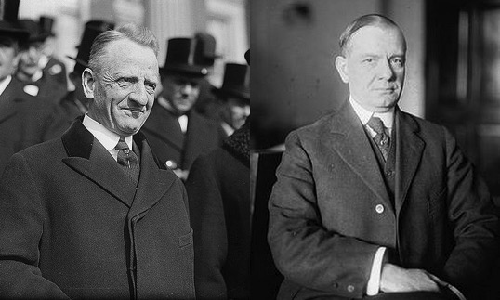
THE EVOLUTION OF THE AMERICAN BANKING SYSTEM
Another Glass-Steagall Act (1933) separated banks into two categories:
Commercial banks: depository banks that accepted deposits and were covered by deposit insurance.
Investment banks: banks which engaged in creating and trading financial assets but were not covered by deposit insurance because their activities were considered riskier.
Carter Glass
and
Henry B. Steagall
Notes:
Image courtesy of Library of Congress

Slide 12
The Great Depression: The Issues and Ideas
What macroeconomic theories can explain the Great Depression?
Classical economics of the time had no well-developed theory that could explain the persistent and excessive unemployment OR any policy recommendations to solve the problem
The Great Depression and the inadequacy of prevailing economic theories was the setting for John Maynard Keynes and his famous work The General Theory of Employment, Interest, and Money

Slide 13
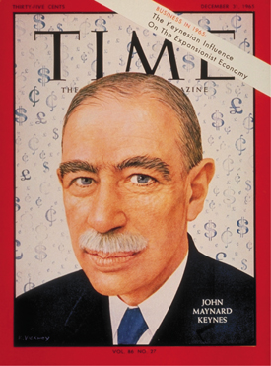
MACROECONOMICS: THEORY AND POLICY
Pre-1930s conventional wisdom
Self-regulating economy: Problems such as unemployment are resolved without government intervention through the working of the invisible hand.
Post-1930s conventional wisdom
Keynesian economics: Economic slumps are caused by inadequate spending, and they can be mitigated by government intervention.

Slide 14
The Keynesian Explanation
Essence of the Keynesian explanation of the Great Depression is contained in the simple aggregate demand model
Growth in the 1920s based on:
Mass production of the automobile
Mass production of the radio
Housing boom
Collapse in the 1930s resulted from:
Drying up of investment opportunities
Reduction in consumption expenditures
Poor fiscal policy

Slide 15
The Keynesian Explanation
The Great Depression showed:
The private economy was inherently unstable
Active stabilization policy needed to maintain a strong economy
Keynesian model offered:
An explanation for what had happened
Suggestions for policy measures that could have prevented the Great Depression
Suggestions for policy measures to prevent future depressions

Slide 16
The Monetarist Challenge
Keynesian emphasis on fiscal policy and its downplaying of the role of money was challenged by Milton Friedman and his coworkers in the 1950s
Friedman emphasized the role of monetary policy in determining the behavior of output and prices
He argued that the Depression was evidence of the importance of monetary factors
Failure of the Fed to prevent bank failures and decline of money stock was largely responsible for the severity of the depression

Slide 17
Synthesis
Both Keynesian and Monetarist explanations fit the facts of the Great Depression → Inept fiscal and monetary policy made Great Recession severe
Lessons and ways to avoid another Great Depression:
Would not attempt to:
Raise taxes
Balance budget
Would:
Attempt to keep money supply from falling
Not allow bank failures to reduce money stock
Larger government role in economy

Slide 18
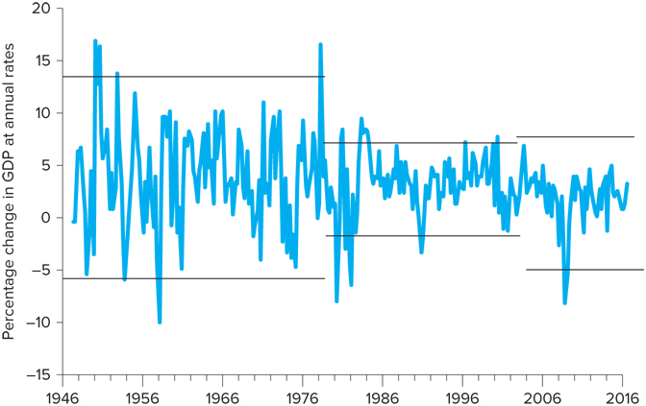
The Great Moderation
Wide fluctuations in business cycle during early decades of post-war period
Dampened out between 1980-2007 → Great Moderation

Slide 19
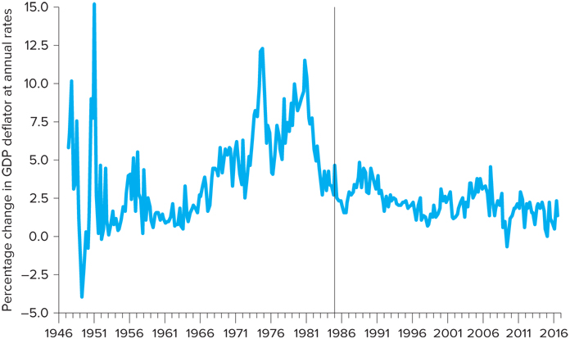
The Great Moderation
Inflation also brought under control during Great Moderation
Financial crisis demonstrated macroeconomic policy might be better but shocks are still with us

Slide 20
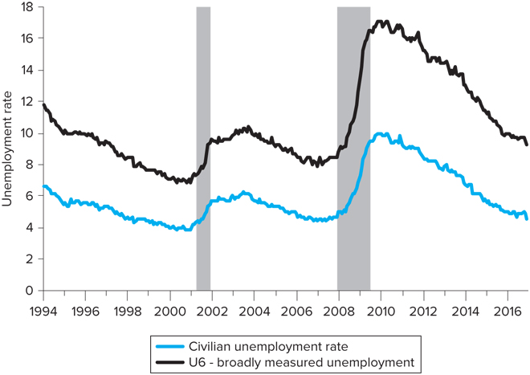
The Great Moderation
Great Recession was bad, but not a revisit of the Great Depression
At the peak, close to 1 in 6 were unemployed or underemployed during the Great Recession

Slide 21
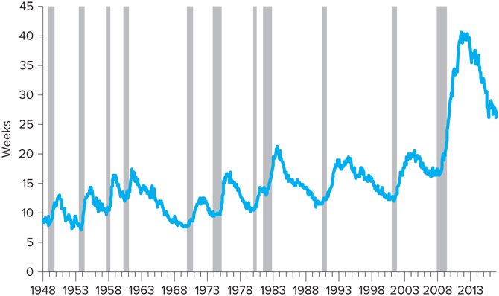
The Great Moderation
Long-term unemployment of Great Recession hard on households, which continued several years after the official end of the recession

Slide 22
Fight of the Century - Keynes vs. Hayek
Friedrich August Hayek is best known for his defense of free-market capitalism.
Unlike Keynes, Hayek believed that a recovery from a post-boom crash called not just for adequate spending, but for a return to sustainable production.
https://www.youtube.com/watch?v=LA1-1DlhuXU

